Slide 1



Slide 2


PROBLEM STATEMENT
Academic information is scattered across WhatsApp groups, PDFs and different platforms — making it hard to track attendance, find study materials and access academic resources.
CSE (ICB) Department Integrated
Academic and Information Portal
TEAM NAME & MEMBERS
S T A C K X
D V Manas Srujan
Hussain Basha
M Pavani Gowda
Purvi B V
1KS25IC015
1KS25IC023
1KS25IC033
1KS25IC045
DEPARTMENT OF COMPUTER SCIENCE & ENGINEERING — ICB

Slide 3









From Scattered Information to One Platform
REAL-WORLD EXPERIENCE
When we are first-year engineering students, we experienced difficulties tracking subject-wise attendance and finding study materials shared earlier in WhatsApp groups.
WhatsApp Groups
Many Messages
Notices Get Buried
Difficult to Find
Scattered Information
Difficult to Find Materials
Attendance Tracking
Resources in Different Places
Updates get mixed with many messages
Old PDFs, notes and syllabus are hard to locate
Difficult to track subject-wise attendance
Papers, courses and certifications are not centralized
Syllabus
Study Materials
Previous-Year Papers
Research Papers
Online Courses
Certifications
DEPARTMENT OF COMPUTER SCIENCE & ENGINEERING — ICB

Slide 4






Proposed System — Features & Conceptual Demo
CONCEPTUAL UI · FUTURE DEVELOPMENT
Student Dashboard
CONCEPT
Teacher Dashboard
CONCEPT
Department Dashboard
CONCEPT
92%
5
4
12
3
1
Attendance
Assignments Due
Sections
Pending Reviews
Notices Today
Event This Week
Marks & Performance
Record Attendance
Academic Calendar
Timetable
Manage Marks
Resource Library
Study Materials
Announcements
User Management
STUDENT FEATURES
TEACHER FEATURES
DEPARTMENT FEATURES
Subject-wise Attendance
Upload Materials
Notifications
Study Materials
Manage Assignments
Timetable & Calendar
Assignment Tracking
Record Attendance
User Management
Marks & Performance
Manage Marks
Resource Library
Academic Resource Hub
Announcements
Academic Information
DEPARTMENT OF COMPUTER SCIENCE & ENGINEERING — ICB

Slide 5



OUR VISION
One Platform. One Department.
Better Academic Management.
Our goal is to create a centralized platform where students can access and track academic information, teachers can manage academic content, and the department can organize resources and communication.
STUDENTS
TEACHERS
DEPARTMENT
Access • Track • Learn
Share • Manage • Evaluate
Organize • Communicate • Monitor
Thank You
Questions & Discussion

Slide 6
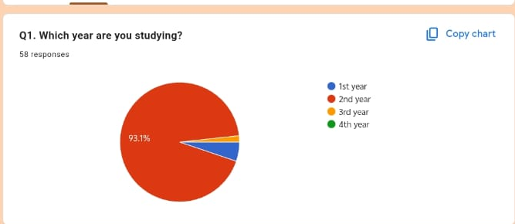
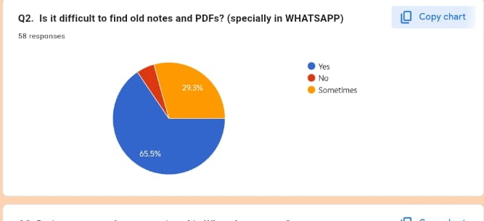
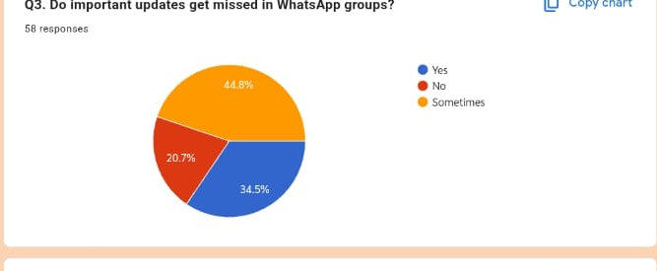
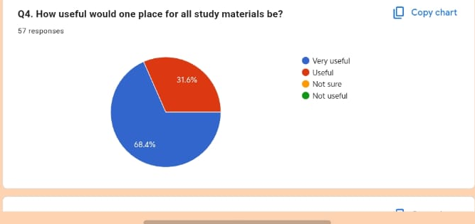
Survey Results – Current Challenges (25/09/2026)
On 26/09/2026, we surveyed students to understand the academic problems they face in managing notes, PDFs and important WhatsApp updates. The responses show that finding old study material is a major difficulty, while important updates are also missed in group conversations. These findings support the need for a centralized academic portal.
Q1–Q4 · STUDENT EXPERIENCE
DEPARTMENT OF COMPUTER SCIENCE & ENGINEERING — ICB

Slide 7
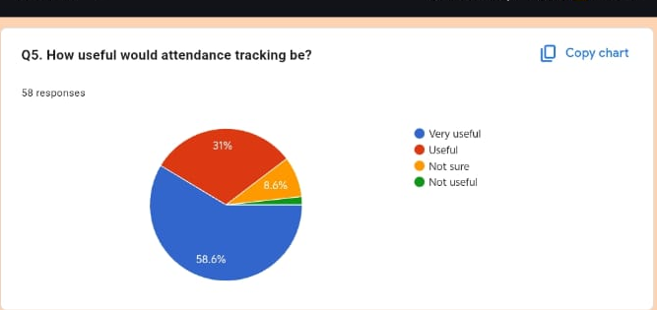
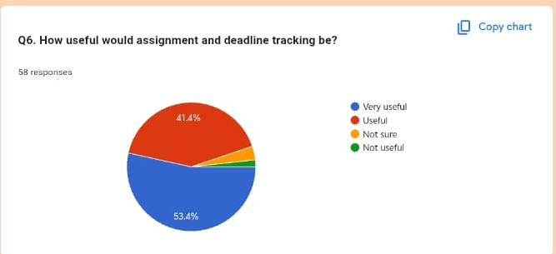
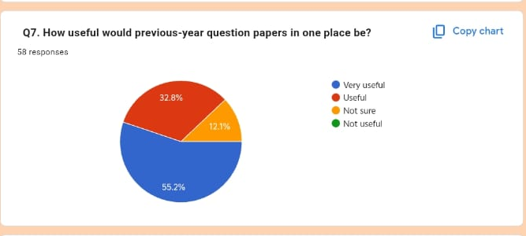
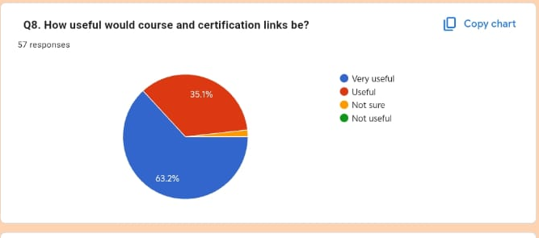
Survey Results – Proposed Features
Students were asked how useful they would find attendance tracking, assignment and deadline tracking, previous-year question papers, and course/certification links. Most respondents rated these features as useful or very useful, indicating strong demand for tools that organize academic information and help students keep track of their work.
Q5–Q8 · FEATURE USEFULNESS
DEPARTMENT OF COMPUTER SCIENCE & ENGINEERING — ICB

Slide 8
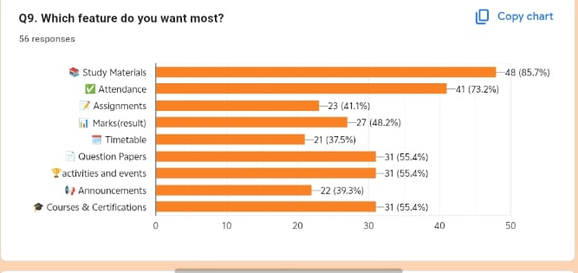
Survey Results – Feature Priorities
The final survey question asked students which portal features they would want most. Study materials received the highest preference (48 students, 85.7%), followed by attendance (41, 73.2%). Question papers, activities and events, and courses/certifications were each selected by 31 students, showing that students want both core study resources and broader academic support.
Q9 · FEATURE PREFERENCES
DEPARTMENT OF COMPUTER SCIENCE & ENGINEERING — ICB

Slide 9
THANK YOU

